Slide 1
READ ME
This program is meant to represent a user interface for a car rental company that is set 1000 years into the future.
The buttons at the top are used as directions to view different pages of the program. The top right has a login button that is designated for storing the user’s information, DL#, and age to verify that they are eligible to rent a car (Now 30 years old in the year 3000). Other pages display company information, contact information, and vehicle information so that the user can make an informed decision about their rental.
All of this data is stored within the classes and subclasses for easy recall from the controllers and main script.

Slide 2
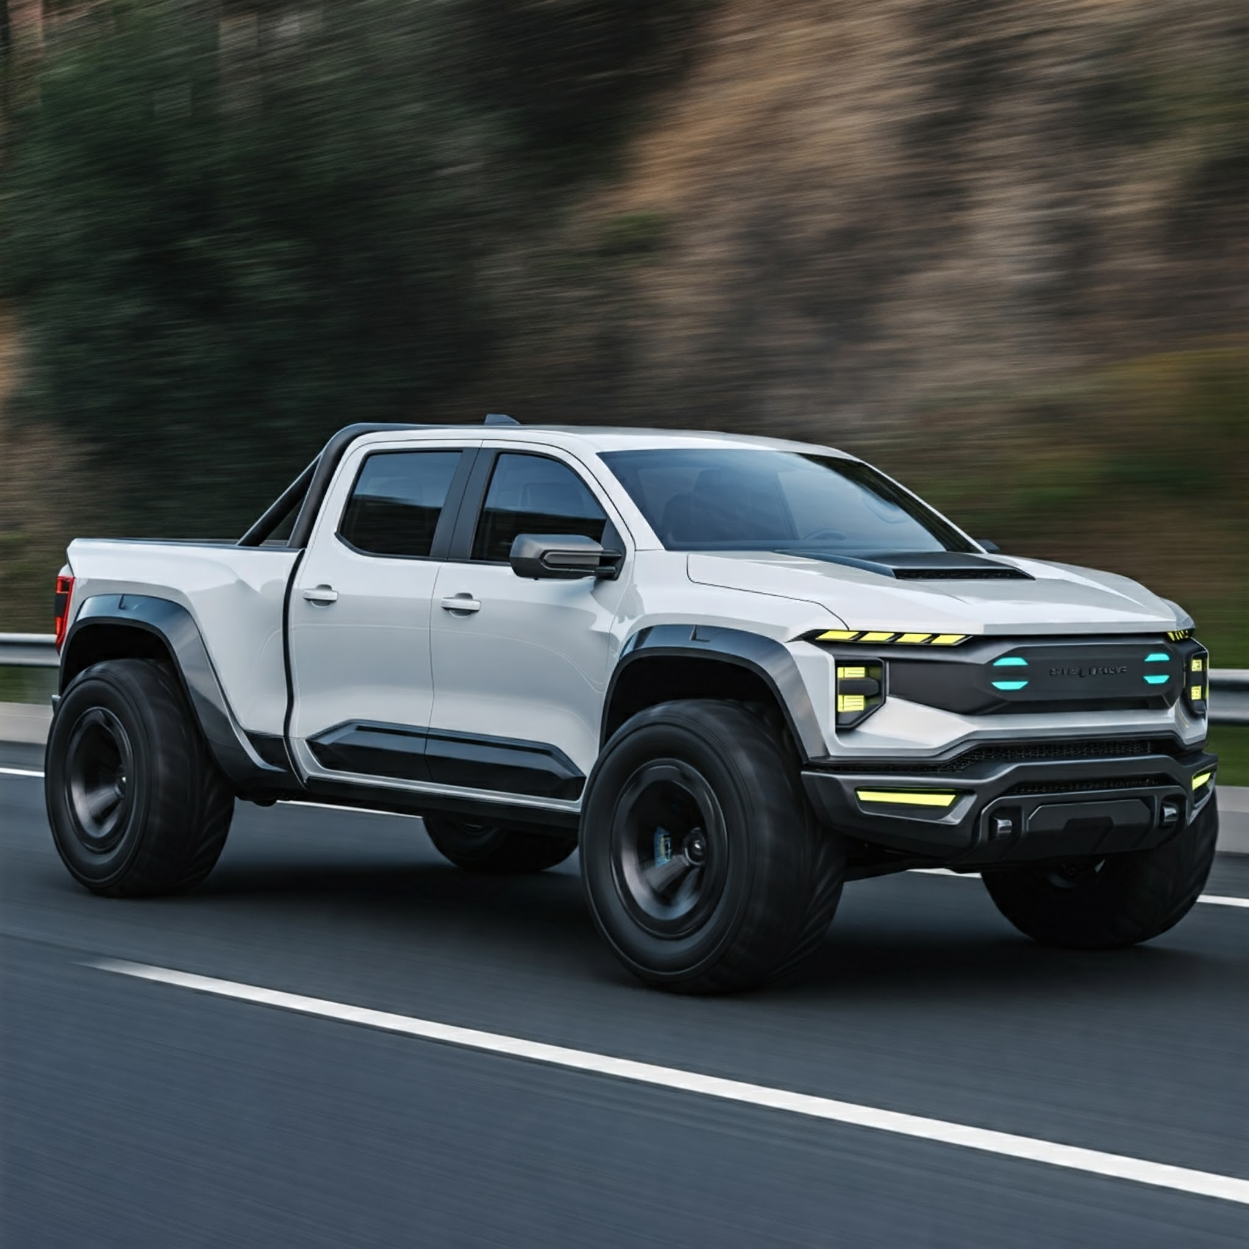
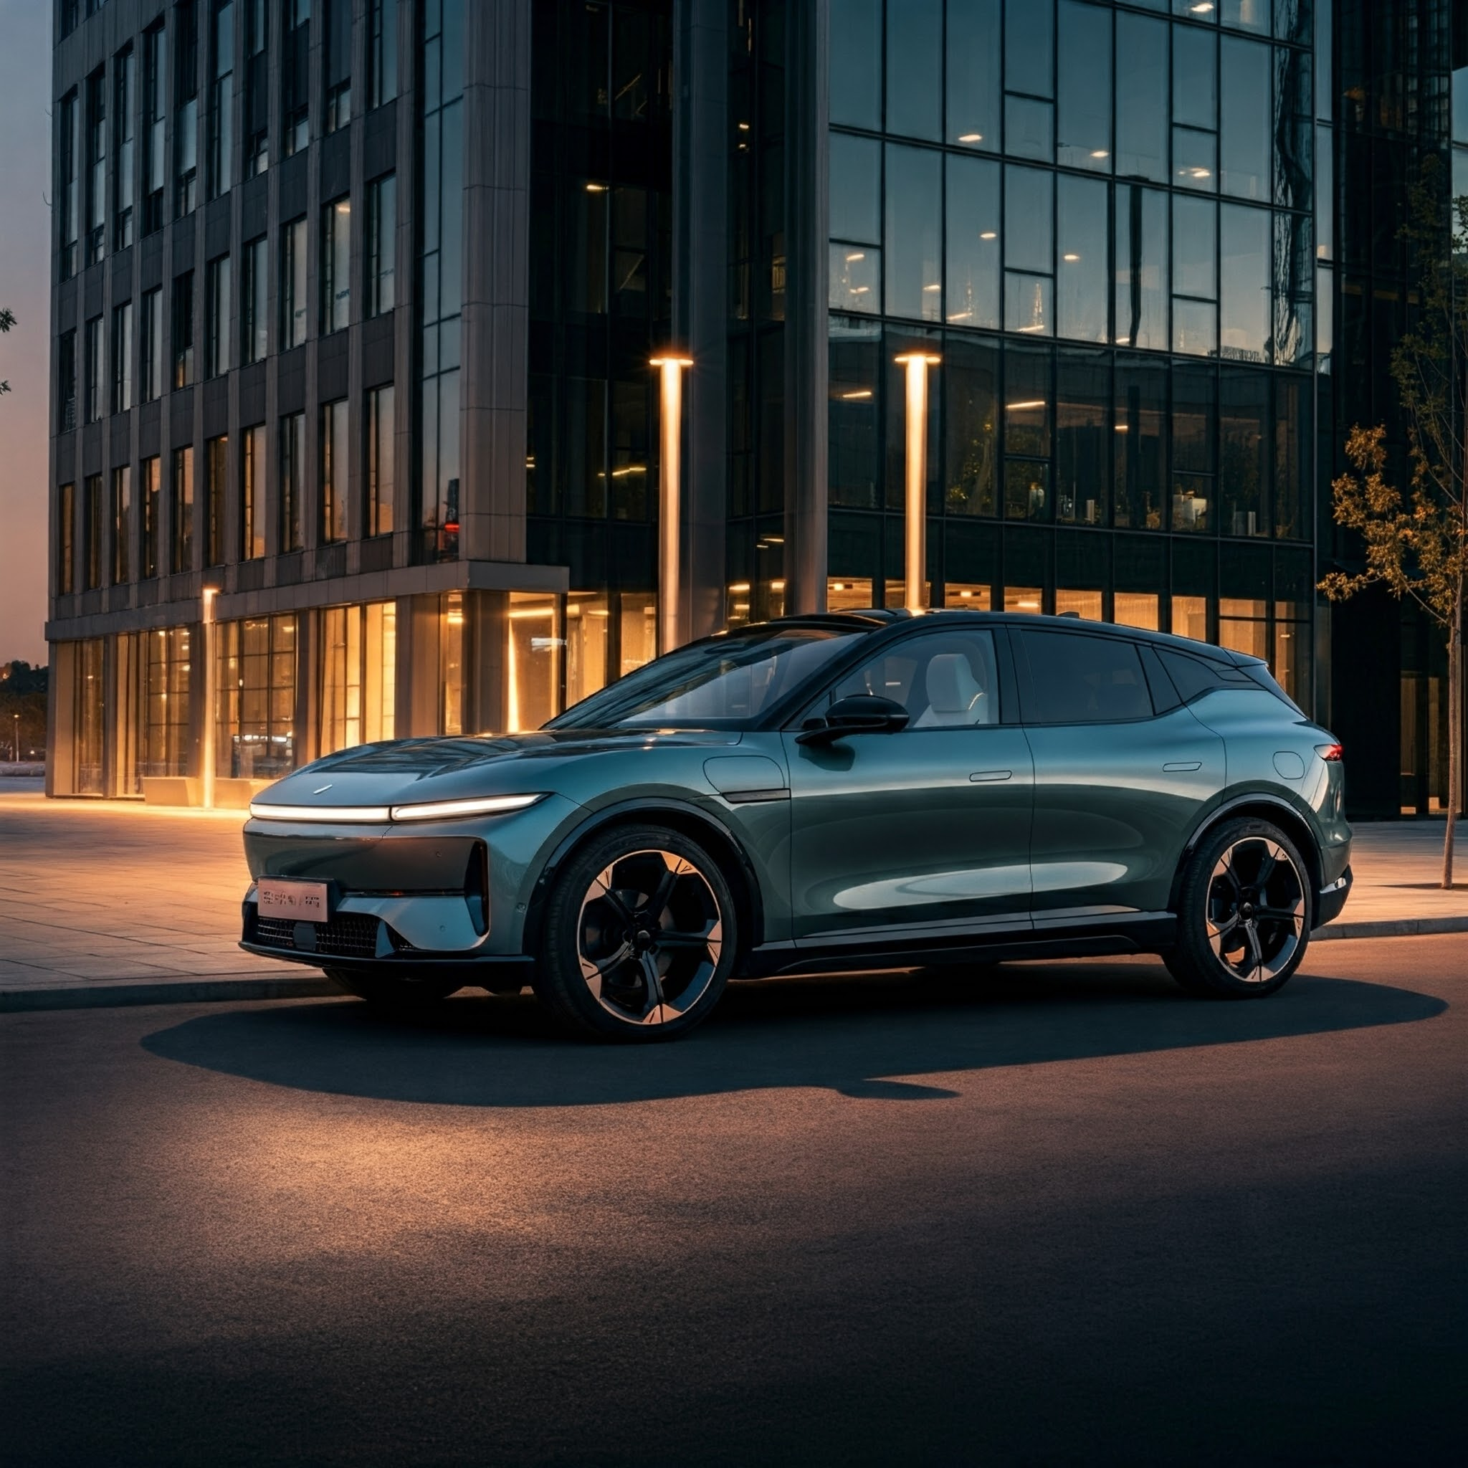
HOME PAGE
Input user info
ExclusiCar
Rentals
LOGIN
Temp logo
Home About Us Contact
Navigation
Our Vehicles
Truck
EV SUV
Starting at $100
Learn More…
Starting at $120
Learn More…
Button to open more info

Slide 3
Login Overlay
ExclusiCar
Rentals
LOGIN
Home About Us Contact
Signup
Page overlay
LOGIN
Our Vehicles
Email:
Password:
User enters info
Truck
EV SUV
Starting at $100
Learn More…
Starting at $120
Learn More…

Slide 4
Signup Overlay
ExclusiCar
Rentals
LOGIN
Home About Us Contact
Signup
Page overlay
Signup
Our Vehicles
Email:
Password:
DL #:
DOB:
User enters info
Truck
EV SUV
Starting at $100
Learn More…
Starting at $120
Learn More…

Slide 5
ExclusiCar
Rentals
LOGIN
Home About Us Contact
Signup
Titanium Commander
Seating: 5
Gas Mileage: 80 mpg
Make: Titanium
Model: Commander
Year: 3000
Top Speed: 140 mph
Towing Capacity: 6900 lbs
Rental Price: $100/day
Page overlay, non interactable

Slide 6
ExclusiCar
Rentals
LOGIN
Home About Us Contact
Signup
NovaFlux SUV
Seating: 8
EV Range: 600 miles
Charge Time: 30 minutes
Make: NovaFlux
Model: NovaFlux SUV
Year: 2999
Top Speed: 169 mph
Trunk Space: 50 cubic feet
Price to Rent: $120/day
Page overlay, non interactable

Slide 7
ABOUT US
ExclusiCar
Rentals
LOGIN
Home About Us Contact
Signup
About Us
High end car rentals for all your daily needs. Founded in 2950, we keep only the highest quality vehicles to suit your needs. Our small selection allows us to keep up with the interplanetary demands, allowing the customer to get the same experience throughout the solar system.
Page overlay, non interactable

Slide 8
ABOUT US
ExclusiCar
Rentals
LOGIN
Home About Us Contact
Signup
Contact
Talk to an AI ChatBot HERE!
For further assistance, contact rentalhelp@exlcusicar.com
Page overlay, non interactable

